Slide 1
Project Proposal AI-Driven Guest Profiling For Hotel Management (United States/New Jersey) Mithun Dama

Slide 2
Targeted Problem : The hospitality industry faces challenges in operation efficiency and customer experience management. Our AI-based system aims to streamline hotel operations, enhance guest satisfaction, and optimize resource management.
Research Questions
How can AI technologies improve operational efficiency in hotel management?
What are the impacts of AI on guest experience and staff workload?
Dataset: Sourced from simulated hotel operations, encompassing:
10,000 guest interactions and reservations.
Data includes Guest details, stay dates, preferences, feedback, and service utilization.
Size
The dataset simulates transactions and interactions for a mid-size hotel over a year.
Motivation
Technical: To explore the application of AI in solving real-world problems within the hospitality industry, specifically through data-driven decision-making and predictive analytics.
Personal: A passion for harnessing technology to transform traditional industries, combined with a specific interest in the evolving dynamics of hospitality management.
Justification The project is justified by the need for:
Enhanced customer service.
Efficient resource management.
Data-driven decision-making in the hotel industry.
Expected Outcome A prototype of an AI-integrated hotel management system capable of:
Real-time data analysis for improved guest experiences.
Predictive modeling for occupancy and resource allocation.
Automated guest service operations.

Slide 3
Literature Review
By
Mithun Dama

Slide 4
"An AI Integrated Online Hotel Management System"
Goal: Develop an AI-integrated online hotel management system to:
Simplify daily hotel operations.
Enhance user experience.
Bridge the communication gap between hotel employees and customers.
Dataset:
User details: Email, Phone, Address.
Room/Table specifics: Type, Price, Capacity.
User credentials: Name, Password, Mail.
Methodology: Divided system into distinct modules: User Interface, Registration, Login, Admin, Customer, and Chatbot. Utilized Dialog Flow for chatbot (Jarvis) to interact in English and Hindi.
Results: Centralized information system, Enhanced data security through unique authentication, Integration of a chatbot for improved user interaction, 360° view of the hotel provided.
Conclusion: The AI-integrated online hotel management system enhances the hotel booking experience, offering a user-friendly interface and effective communication between hotel staff and customers.
Link: Journal of Web Engineering & Technology, Volume 9, Issue 1
By: Deshpande

Slide 5
Machine Learning in the Hotel Industry
Research Questions or Goal:
Where does the hotel industry implement machine learning?
What are the machine learning techniques used in the hotel industry?
Which countries are using machine learning in the hotel industry?
Dataset:
Data from online reviews (TripAdvisor, Booking.com), interviews, online ratings, and online surveys.
Results & Limitations:
Results:
a) Machine learning is applied in areas like understanding online reviews, demand forecasting, price prediction, and cancellation prediction.
b) Several machine learning algorithms have been employed, including XGBoost, Naive Bayes Classifier, and Random Forest Regression.
c) China leads in implementing machine learning in the hotel sector, followed by the USA, Portugal, Spain, and the UK.
Limitations:
a) Current research predominantly focuses on reviews from social media and hotel booking platforms.
b) There's a psychological fear that automation might lead to job loss in certain hotel sectors.
c) Limited interaction between guests and hosts due to machine learning solutions might be a concern.
Conclusion:
Future Potential: By embracing machine learning, the hotel industry can enhance service quality, streamline operations, and boost revenue. This requires investment in infrastructure, training, and strategic planning.
Link: https://jaauth.journals.ekb.eg/
By: Eid Alotaibiy (JAAUTH)

Slide 6
Real-world Conversational AI for Hotel Bookings:
Goal:
Develop a real-world conversational AI system for hotel search and booking via text messaging platforms.
Dataset:
Database of ~100,000 cities and 300,000 hotels, supplemented with user-agent conversation data.
Methodology:
Intent Classification: Utilized a two-stage model (keyword-matching and neural classification) to categorize user messages.
Named Entity Recognition (NER): Deployed custom models with Spacy to identify hotel and location names.
Information Retrieval (IR): Combined NER, Elasticsearch, and neural networks (including BERT with fine-tuning) to match user queries with database entries.
Results:
BERT-based IR model achieved ~90% accuracy in retrieving correct hotel matches.
External real-world performance metrics showed improved agent handoff and booking completion rates.
Conclusion: The developed chatbot effectively aids hotel bookings, highlighting the potential of chatbot technology in e-commerce.
Link: arXiv:1908.10001v1 [cs.LG] 27 Aug 2019
By: Bai Li, Nanyi Jiang, Joey Sham, Henry Shi, Hussein Fazal (From “University of Toronto & SnapTravel, Toronto, Canada”)

Slide 7
Artificial Intelligence (AI) in the Hospitality Industry: A Review Article
Research Questions or Goal:
To evaluate the literature on AI adoption in the hospitality industry.
Dataset:
Literature and information from various books and research articles obtained from EBSCO, Google Scholar, Scopus, Web of Science, and ScienceDirect.
Methodology:
Narrative synthesis used for the review.
Systematic review of literature on AI in the hospitality industry.
Inclusion criteria: Studies that defined AI in all hospitality aspects, written in English, and peer-reviewed.
Qualitative content analysis was employed.
Results & Limitations:
Results:
AI technologies assist businesses in the hospitality sector by improving customer service, expanding operational capability, and lowering costs.
AI has both positive and negative effects on the workforce and job employment in the hospitality industry.
Limitations:
Risks associated with AI include job loss in low-tech sectors, loss of control due to robot autonomy, and concerns over safety, security, and privacy.
Conclusion:
AI technologies have significant implications for the hospitality industry, offering both opportunities and challenges. It's essential for businesses in the hospitality sector to understand these technologies and implement strategies to meet both customers' and employees' needs.
Link: International Journal of Computing Sciences Research
By: Author: Pongsakorn Limna, Affiliation: Rangsit University, Thailand, Email: palmlimna@gmail.com, ORCID ID: orcid.org/0000-0002-7448-5261

Slide 8
Hotel Classification Visualization Using Natural Language Processing of User Reviews
Research Questions or Goal:
a) How can natural language processing (NLP) be used to analyze word-of-mouth communication among consumers regarding their experiences with various hotels?
b) Can NLP categorize and visualize language patterns based on the value the hotel enterprises provide for their customers?
Dataset: Source: Online word-of-mouth communication samples from Yelp, focusing on hotels based in New York.
Size: 1,064 word-of-mouth communication samples. This includes data from one five-star hotel, three four-star hotels, two three-star hotels, and two two-star hotels.
Results & Limitations:
Results:
Three-star hotel (Hotel F) was evaluated as the best provider of values to their customers.
Five-star hotels, Hotels A and B, were not evaluated well by customers in terms of room cleanliness or location.
Three-star hotels were evaluated more positively than the higher-rated ones in terms of room cleanliness or location.
Limitations:
The study relied on online reviews, which might not be fully representative of all hotel guests' opinions.
The classification may be influenced by user expectations based on hotel pricing and ratings
Conclusion:
The study offers a novel method for classifying hotel enterprises based on the value they provide to customers using NLP.
The results can assist customers in choosing a hotel and help managers develop effective marketing strategies.
The findings suggest that user ethnicities may influence customer satisfaction with certain hotel services.
Link: https://ieeexplore.ieee.org/
By: Takayuki Suzuki, Kiminori Gemba, and Atsushi Aoyama from Graduate School of Technology Management, Ritsumeikan University, Shiga, Japan

Slide 9
Application of Face Recognition in Smart Hotels
Research Questions or Goal:
The goal of this research is to explore the application of face recognition technology in smart hotels. It delves into the benefits of integrating face recognition technology into hotel management systems, such as facilitating quicker guest passage, aiding in hotel management, and enhancing the guest experience with high-tech conveniences.
Dataset: Not explicitly mentioned in the provided text.
Results & Limitations:
Results:
Proposed application scenarios for face recognition in smart hotels:
Face check-in: Enables guests to register, verify their identity, and open doors using facial recognition. It can be done both manually and via self-service machines.
Face ladder control: Allows management to control elevator access based on facial recognition.
Face consumption: Integrates with the hotel management system to facilitate payment, replacing traditional coupons or cards.
Stranger control: Enhances hotel safety by identifying and alarming about strangers using face and body information.
The paper emphasizes the importance of combining emerging technologies like cloud computing, big data, AI, and IoT to build a decision-making system in smart hotels.
Limitations: The specific limitations of the study or technology are not explicitly mentioned in the provided text.
Conclusion: The application scenarios based on face recognition technology in smart hotels are optimized and improved through theoretical research and AI technology. The foundation for realizing a smart hotel lies in its basic hardware facilities and management system. It's essential to merge emerging technologies to create a decision-making system that can elevate the customer experience and enhance hotel management efficiency.
Link: https://ieeexplore.ieee.org/stamp/stamp.jsp?tp=&arnumber=9302014
By: Zhang-Bin Chen and Yang Liu

Slide 10
Hotel Booking Cancellation Prediction using ML algorithms
Research Questions or Goal:
The primary aim is to predict hotel booking cancellations using Machine Learning models. By leveraging past data from hotels, the models are trained to predict cancellations, helping hotel management make better decisions regarding their policies and actions.
Dataset: The data are sourced from Kaggle. Features in the dataset include 'hotel', 'arrival_date_month', 'meal', 'market_segment', 'distribution_channel', 'reserved_room_type', 'deposit_type', 'customer_type', 'year', 'month', 'day', and 'cancellation'.
Results & Limitations:
Results: Machine learning models have been developed and trained using past data from hotels, enabling them to predict the possibility of booking cancellations. The predictive capability of the models helps the hotel management to take appropriate actions to minimize cancellations and consequently, revenue loss. Additionally, interactive dashboards were created using POWERBI for hotel management to view and analyze data, aiding in timely decision-making.
Limitations: The document does not explicitly mention limitations, but as with most predictive models, there might be challenges related to the accuracy of predictions, overfitting, and the applicability of the model in diverse scenarios.
Conclusion: Machine learning models have been developed and trained to predict hotel booking cancellations. The trained models can discern patterns of cancellations, helping in averting revenue loss for the hotel industry. Interactive dashboards built using POWERBI further empower hotel management to make timely decisions based on data analytics.
Link: DOI: 10.1109/ICAIS53314.2022.9742843
By: M. Venkata Rakesh (venkatarakesh4281@gmail.com) - Student, Department of CSE, Sathyabama Institute of Science and Technology, Chennai.

Slide 11
Enabling a Massive Data Collection for Hotel Receptionist Chatbot Using a Crowdsourcing Information System
Research Questions or Goal:
The research aimed to solve the problem of collecting a large dataset for training a hotel receptionist chatbot by:
Developing a reliable crowdsourcing information system to collect and store the dataset.
Creating a user experience that stimulates crowd workers to provide more data.
Dataset: The dataset consists of question-answer pairs relevant to the context of hotel receptionist conversations. The system was implemented in a community proficient in hotel management, specifically, lecturers and students in a hotel management major at a university.
Results & Limitations:
Results:
The system, named Catbot, was generally well accepted by crowd workers based on user acceptance tests.
In five days, 234 question-answer pairs were collected.
25 questions were rejected by other crowd workers, indicating a mechanism to maintain the quality of the dataset.
Limitations: The paper does not explicitly mention specific limitations, but it does indicate that rejected questions need further assessment to ensure they are truly invalid.
Conclusion: The researchers presented Catbot, a crowdsourcing system that facilitates the collection of a vast dataset for the development of a hotel receptionist chatbot. The system was well-received by users, and the rejection feature aids in cleaning the dataset. Future deployments of this system can be on a broader scale to collect the necessary dataset for chatbot development.
Link: https://ieeexplore.ieee.org/stamp/stamp.jsp?tp=&arnumber=9211162
By: Reval Levannoza

Slide 12
AI-Driven Guest Profiling for Hotel Management
Author - Mithun Dama
Affiliation - Pace University
Email - md19602n@pace.edu
mithundama1997

Slide 13

Research Questions & Problem Statement
Research Questions:
AI's role in enhancing guest experience?
AI's ability to predict/mitigate hotel issues?
Benefits of real-time guest profiling?
Problem Statement:
Gaps in understanding guest behaviors.
Operational inefficiencies.
Need for a dynamic predictive system.

Slide 14
Literature Review
Key Insights
Positioning & Needs for Our Work
1. AI Integration in Hotel Management
Simplifies operations & bridges communication (Deshpande)
Enhances user experience
2. Machine Learning in the Hotel Sector
Used for demand forecasting & online reviews analysis (Eid Alotaibi)
China leading in AI adoption
3. Natural Language Processing (NLP)
Analyzes online reviews for customer insights (Takayuki Suzuki)
NLP categorizes language patterns based on hotel values
4. Facial Recognition in Hotels
Streamlines check-ins & boosts security (Zhang-Bin Chen and Yang Liu)
5. Predicting Booking Cancellations
ML models trained on past data to forecast cancellations (M. Venkata Rakesh)
Emphasizing guest profiling using AI
Integrating NLP, ML, and facial recognition for a holistic solution
Implementing a guest behavior scoring system

Slide 15
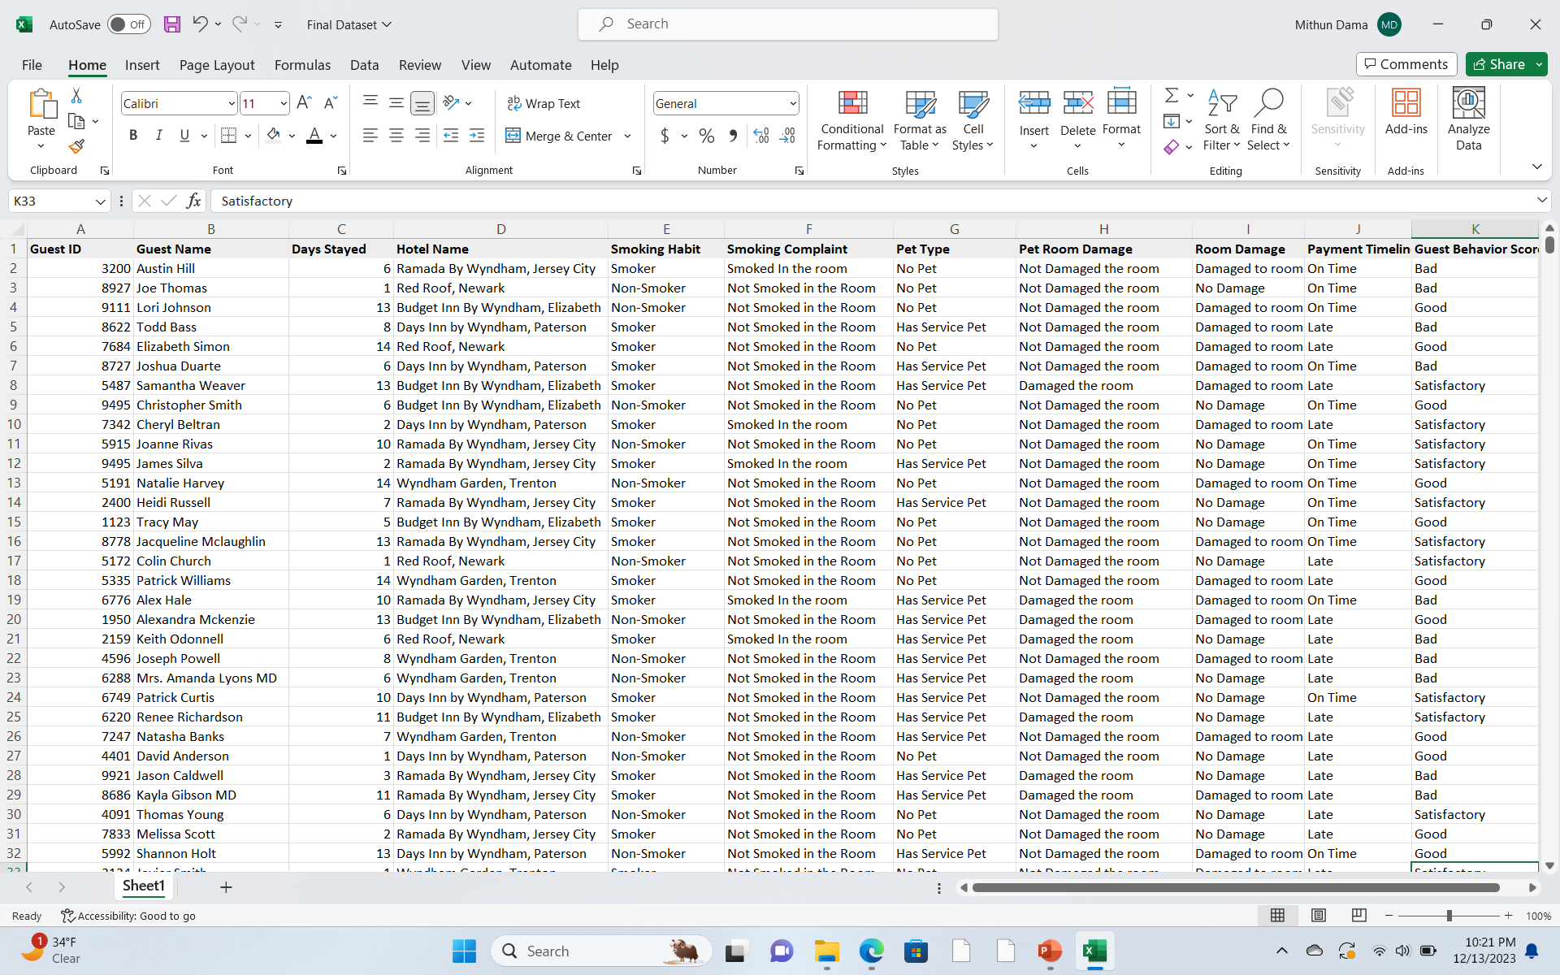
Dataset
Link to the data: Final Dataset.xlsx
Description:
Date: Data generated in September 2023
Country: United States (New Jersey)
Details: This dataset provides a comprehensive view of guests' behaviors, preferences, and interactions with the hotel. It encompasses key metrics and events spanning over a typical stay in a hotel.
Size: 10,000 entries
Parameters:
Guest ID, Guest Name, Days Stayed Hotel Name Smoking Habit Smoking Complaint Pet Type Pet Room Damage Room Damage Payment Timeliness Guest Behavior Score
Note: This dataset is a dummy dataset generated for project purposes.

Slide 16
EDA & Methodology
Preliminary EDA Results:
Correlation Matrix for Numerical Features
Histograms for numerical variables
Bar charts for categorical variables
Heatmap of the correlation matrix
Methodology:
Data Preprocessing: Continuation of cleaning, normalization, and feature encoding for model readiness.
Feature Selection: Not Identified any Predictive Features for the model, So Not generated the New Features.
Model Selection: Used Random Forest Classifier, Gradient Boosting & SVM for better accuracy
Model Validation: Used cross-validation and a holdout set to validate model performance.
Performance Metrics: Accuracy, Precision, Recall, F1-Score to evaluate model effectiveness, with a focus on minimizing false negatives due to business impact.
Experimentation:
Iterative testing of different hyperparameters to tune models for optimal performance.
Use of A/B testing to compare model predictions with actual outcomes and refine, as necessary.

Slide 17
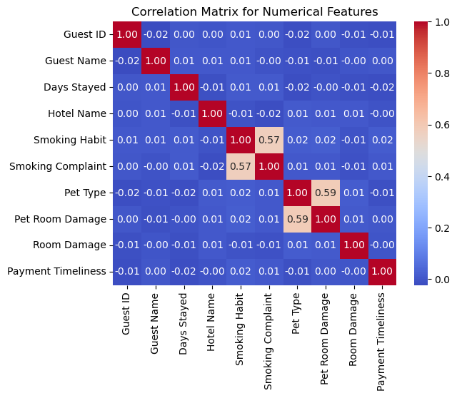
Correlation Matrix
To find an significant relationships between numerical variables We have used this Correlation Matrix for Numerical Features as shown in the fig.

Slide 18
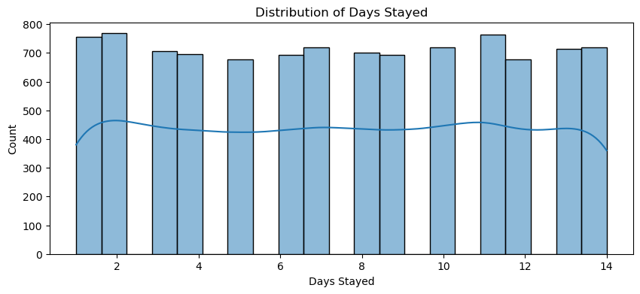
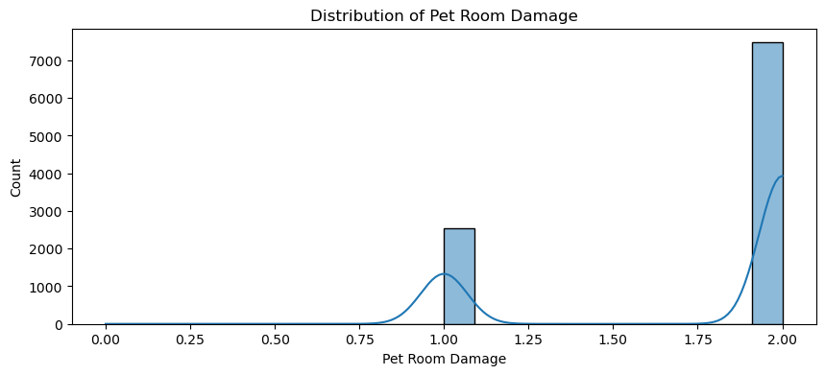
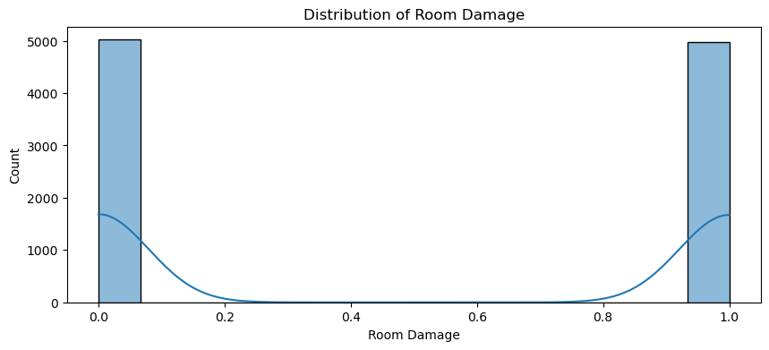
Histograms for numerical variables

Slide 19
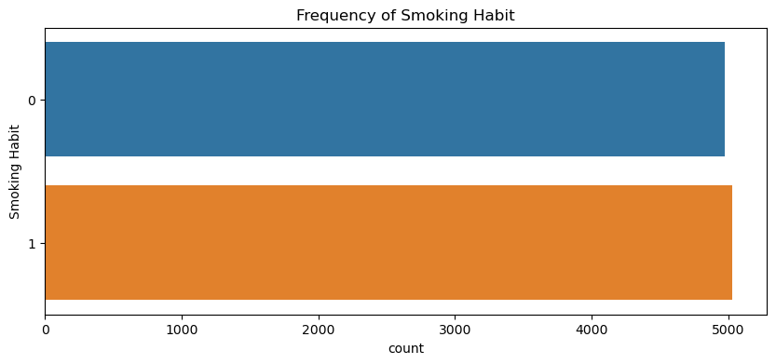
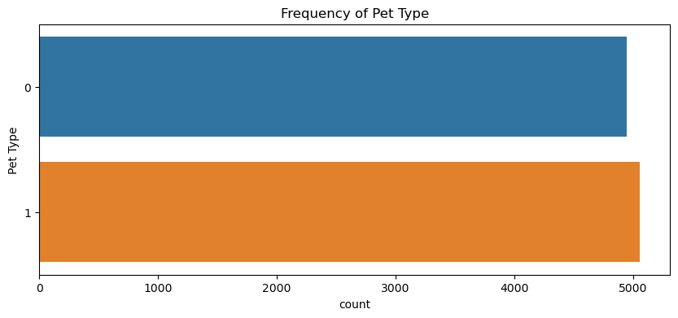
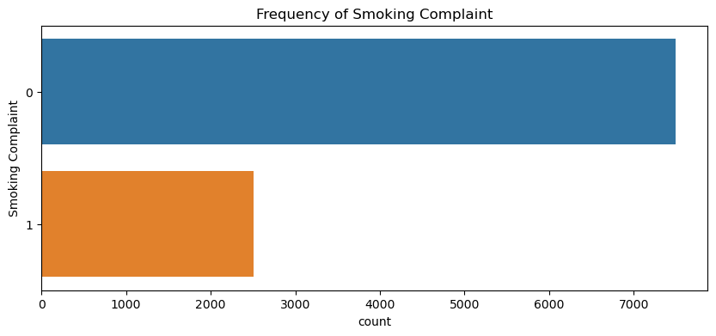
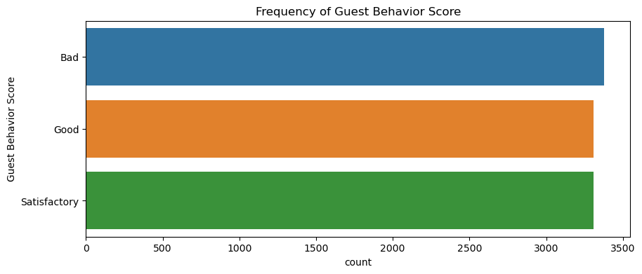
Bar charts for categorical variables

Slide 20
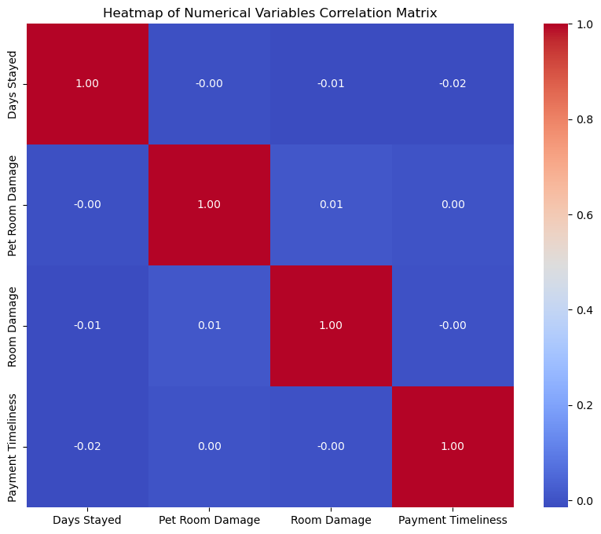
Heatmap of the correlation matrix

Slide 21
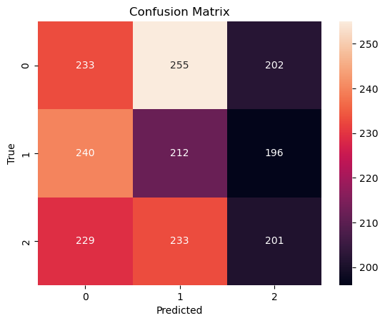
Results
The Random Forest Classifier Performed the Satisfactory for the Dummy Dataset which we generated for this project based on real time features.
Got 61% Model Accuracy using Random Forest Classifier when compared to Gradient Boosting for Dummy Data set.
But When We tried the same model for Real time data the Accuracy of model increases more than the dummy dataset.
The results of the Random Forest Classifier model were evaluated using a confusion matrix.

Slide 22
Conclusion
While Random Forest Classifier demonstrates promising results with Dummy Data to get model accuracy of 62% compared to Gradient Boosting with model accuracy of 56%.
This Findings suggest that AI-driven guest profiling can significantly enhance hotel management with real time data.

Slide 23
Future Work
Future work includes expanding the dataset, incorporating additional features, and exploring advance deep learning approaches for more nuanced behavioral predictions and expanding the dataset to include online behavior and social media interactions.
Project the sample prototype to respective hotel management IT Team, As they have updated some changes and asked to improve the model further by giving some insights.

Slide 24
References
Deshpande. 2022. An AI Integrated Online Hotel Management System. Journal of Web Engineering & Technology, Volume 9, Issue 1. http://computers.stmjournals.com/index.php?journal=JoWET&page=index
Eid Alotaibiy. 2020. Machine Learning in the Hotel Industry. (JAAUTH), Vol. 18 No. 3, (2020). https://jaauth.journals.ekb.eg/
Pongsakorn Limna. 2022. Artificial Intelligence (AI) in the Hospitality Industry: A Review Article. International Journal of Computing Sciences Research. (JAAUTH), Vol. 18 No. 3, (2020) . orcid.org/0000-0002-7448-5261
Takayuki Suzuki, Kiminori Gemba, Atsushi Aoyama. 2023. Hotel Classification Visualization Using Natural Language Processing of User Reviews. Graduate School of Technology Management, Ritsumeikan University, Shiga, Japan.
Zhang-Bin Chen, Yang Liu. 2021. Application of Face Recognition in Smart Hotels. IEEE.
M. Venkata Rakesh. 2022 . Hotel Booking Cancellation Prediction using ML algorithms. Department of CSE, Sathyabama Institute of Science and Technology, Chennai. [DOI: 10.1109/ICAIS53314.2022.9742843]

Slide 25
Thank You

